Slide 1
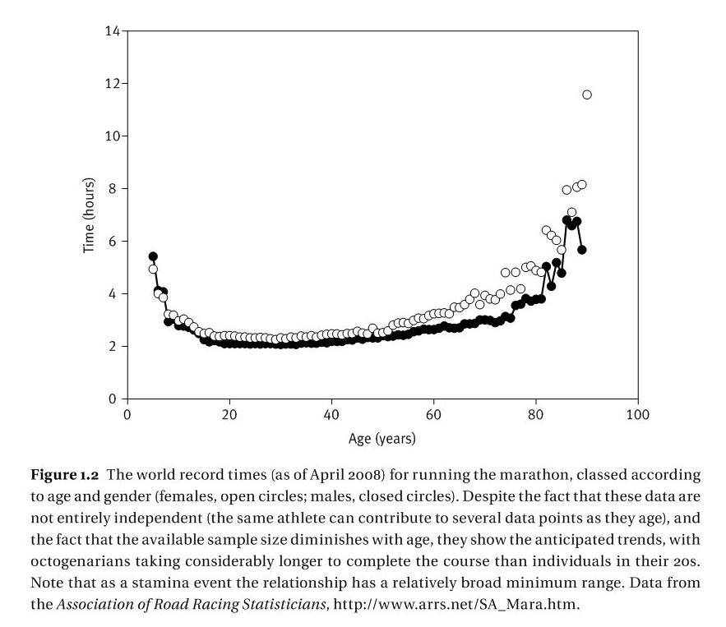
The evolution of senescence

Slide 2
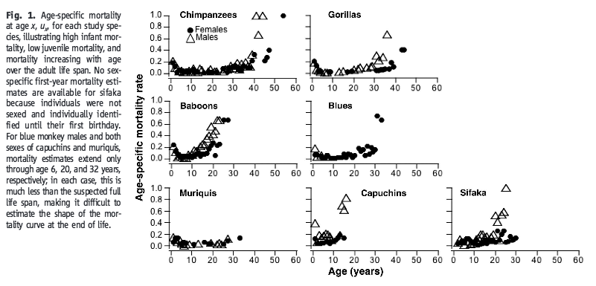
Bronikowski et al 2011. Science

Slide 3
Gompertz-Makeham mortality model
μ_{t} age-dependent mortality rate
t age
c the extrinsic mortality rate
λ a constant multiplier of the mortality rate
γ affects the rate of increase in mortality with age
Fox et al. 2001. Senescence in Evolutionary Ecology: Concepts and case studies. Oxford University Press.

Slide 4
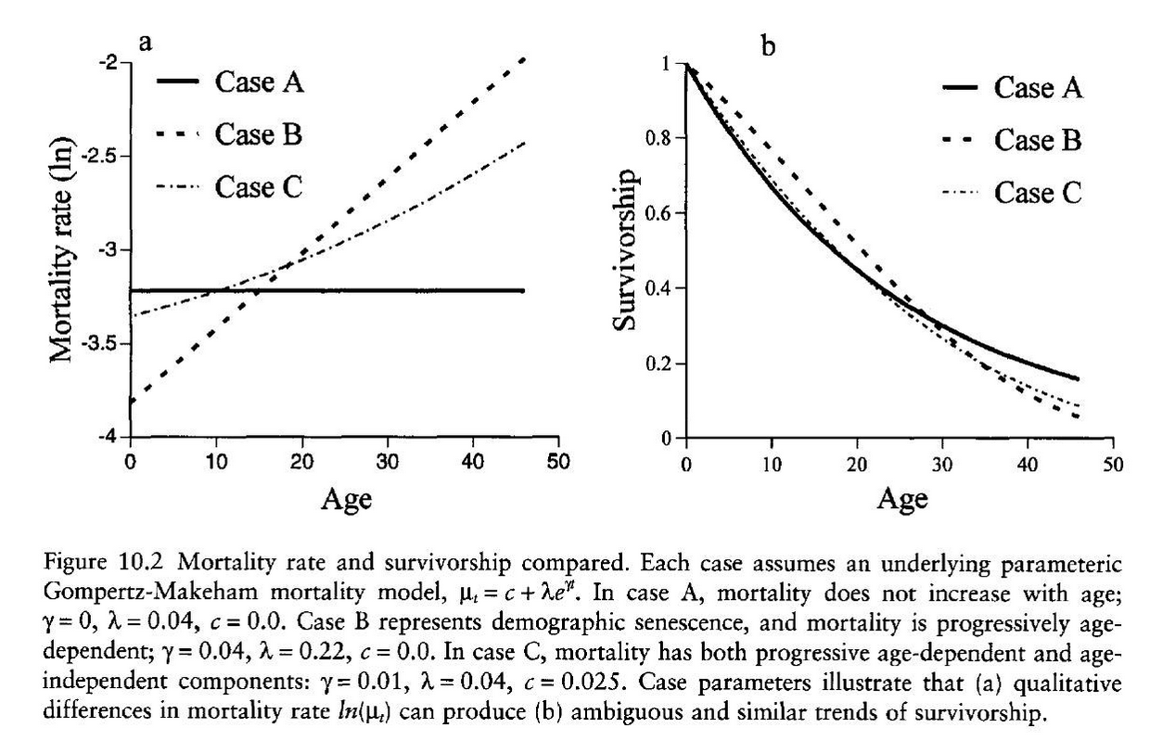
Fox et al. 2001. Senescence in Evolutionary Ecology: Concepts and case studies. Oxford University Press.

Slide 5
Evolution of senescence
Mutation accumulation: Late-acting deleterious effects persist because there is no selection pressure to remove them
Antagonistic pleiotropy: Late-acting deleterious genes have earlier acting benefits
Damage accumulation/Redundancy theory: mortality is avoided if there is at least one functioning copy of a gene
Laird and Sherratt 2009. JEB.

